Slide 1
US ACCIDENTS
Gnanadeep Chinnabathini
Nypunya Jakilati

Slide 2
Introduction
The dataset contains traffic accident records in the U.S. from 2016 to 2019, which covers 49 states of the United States. There are about 3.0 million accident records in it.
This data came from two sources, MapQuest and Bing.
The dataset consists of 49 features which we have divided into 5 categories which are as follows:
Traffic Attributes , Address Attributes , Weather Attributes , POI Attributes , Period-of-Day .
Because of the large size of this dataset and the limited computing power, we choose California as our target state.

Slide 3
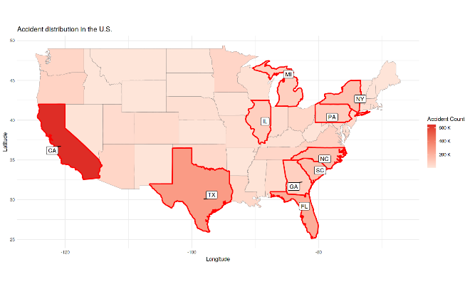
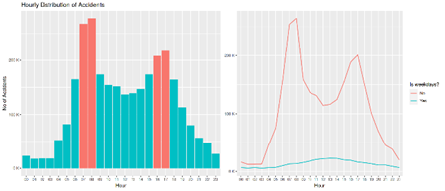
EDA:
Accident count:
Accident account in different time scales:

Slide 4
Data Science methods and challenges
Performed Data preprocessing techniques to handle unwanted features and outliers.
Select a list of features for machine learning algorithm.
Group 4 severity levels into 2 levels
Predict accident severity levels based on traffic accident records by using various models.
Logistic Regression, Sparse Logistic Regression, Decision Tree and Random Forest have been used.
Classifying accidents’ severity by text description

Slide 5
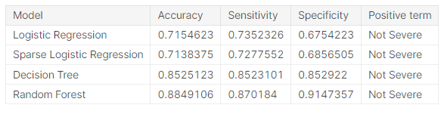
Summary
In conclusion, considering both performance and the time needed to train the model, I prefer using decision tree to make predictions. But if we care about nothing but accuracy, then I suppose random forest will be the winner.
The table below contains the performance of each model:
References
Moosavi, Sobhan, Mohammad Hossein Samavatian, Srinivasan Parthasarathy, and Rajiv Ramnath. “A Countrywide Traffic Accident Dataset.”, 2019.
Moosavi, Sobhan, Mohammad Hossein Samavatian, Srinivasan Parthasarathy, Radu Teodorescu, and Rajiv Ramnath. "Accident Risk Prediction based on Heterogeneous Sparse Data: New Dataset and Insights."

